Slide 1
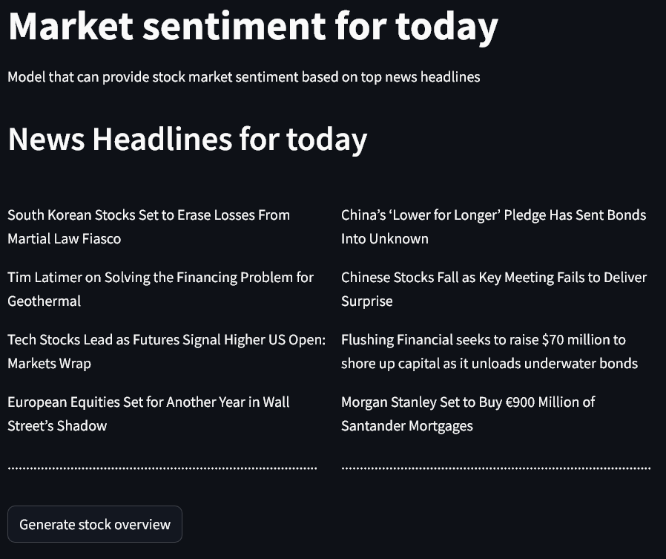
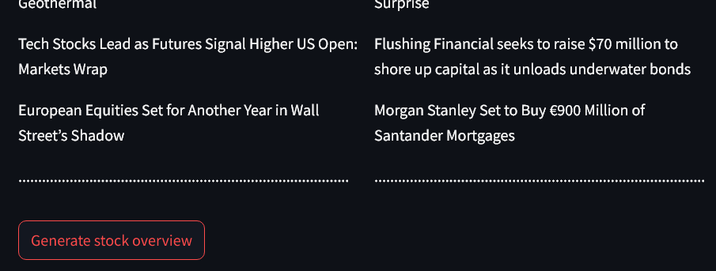
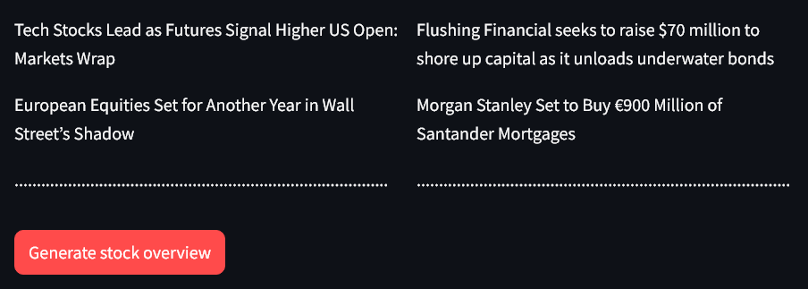
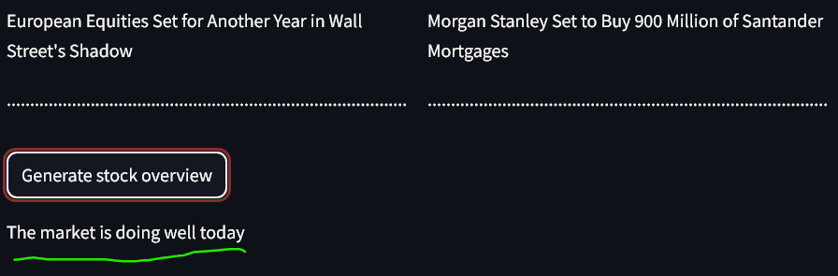
Stock Sentiment Analysis from Top News Headlines
Overview
Develop machine learning model using natural language processing to analyze stock headlines and classify them as having either positive or negative sentiment.
Machine learning model for stock sentiment analysis.
Daniel Enesi, Eniola Farinde, Sunday Ochigbo
Research question
Tons and tons of stock news are released every hour.
This can be very overwhelming for traders and investors seeking to secure the best deals.
With this being a pressing burden, there is the need for automation to help make efficient and smart decisions.
Can we predict the state of the market based on news headlines related to stocks?
User-friendly usage
References
Data
News Headlines Dataset For Stock Sentiment Analyze - Kaggle.com
Sources:
Yahoo Finance
Siddharth Tyagi
Finviz. (n.d.). Market news. Finviz. Retrieved [October 18, 2024], from https://finviz.com/news.ashx
Tetlock, P. C. (2007). Giving content to investor sentiment: The role of media in the stock market. Journal of Finance, 62(3), 1139–1168. https://doi.org/10.1111/j.1540-6261.2007.01232.x
Data Source: Tyagi, S. (2018). News headlines dataset for stock sentiment analysis. Kaggle. https://www.kaggle.com/datasets/siddharthtyagi/news-headlines-dataset-for-stock-sentiment-analyze
Model
Count Vectorization to convert headlines text to vectors
Random Forest Classifier to predict 1/0 based on News Headlines
Sources of BIAS
Date range of 2000 to 2016 might not reflect current market behavior
Using top 25 news headlines might not be enough to decide for a whole day with 100+ news posted.
Future:
Gather more data to increase accuracy of ML model over time
Improve the model response through vector embeddings instead of count vectorization
Validate Model responses through manual/automated stock monitoring
Website for user registration and insights.
Emailing system for daily stock news updates.

